Slide 1
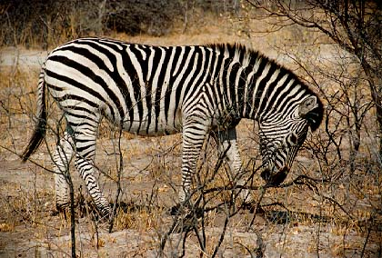
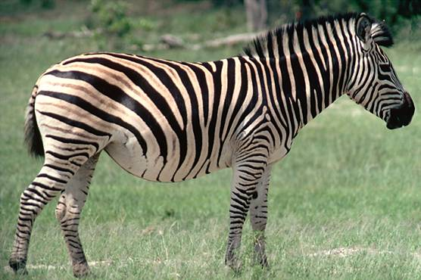

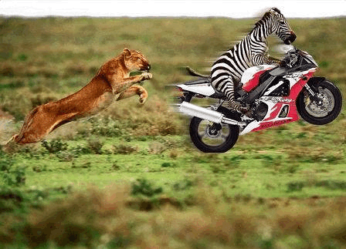
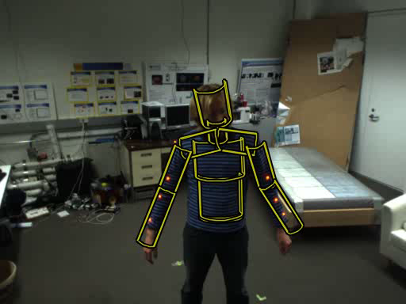
Vision and image processing (VIP), Q2
Audience:
It & Cognition
Computer Science
Content:
Introduction to computer vision with a focus on applications
Format:
Lectures and exercises
Pass/fail based on assignments
Search result
Query

